Slide 1
Linear Regression
Y.LAKSHMI PRASAD
08978784848

Slide 2
Bias-Variance Trade-off

Slide 3
Bias-Variance Trade-Off
Prediction errors can be decomposed into two main subcomponents we care about: error due to "bias" and error due to "variance".
There is a tradeoff between a model's ability to minimize bias and variance.
Bias refers to the model error and variance refers to the consistency in predictive accuracy of models applied to other data sets.
The best models have low bias (low error, high accuracy) and low variance (consistency of accuracy from data set to data set)

Slide 4
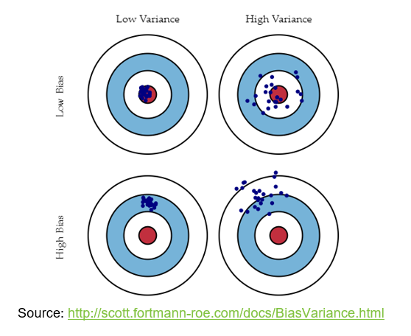
Bias-Variance Trade-Off
Bulls Eye diagram - plots representing combinations of both high and low bias and variance
Centre of the target is a model that perfectly predicts the correct values

Slide 5
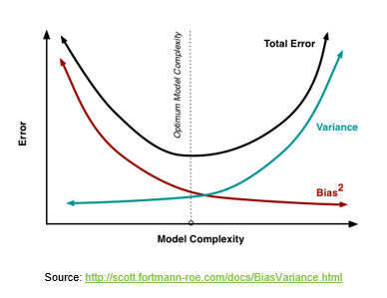
Bias-Variance Trade-Off
Understanding these two types of error can help us diagnose model results and avoid the mistake of over- or under-fitting.
Our goal is to achieve low bias and low variance.
High bias leads to under fitting
High variance leads to over fitting

Slide 6
Cost Function
A cost function is a measure of how wrong the model is in terms of its ability to estimate the relationship between X and Y
This is typically expressed as a difference or distance between the predicted value and the actual value.
Objective of a ML model is to find parameters, weights or a structure that minimizes the cost function.

Slide 7
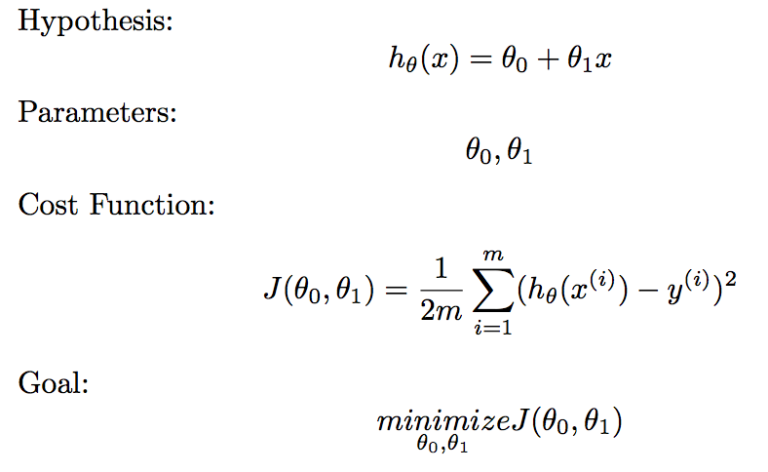
Cost Function

Slide 8
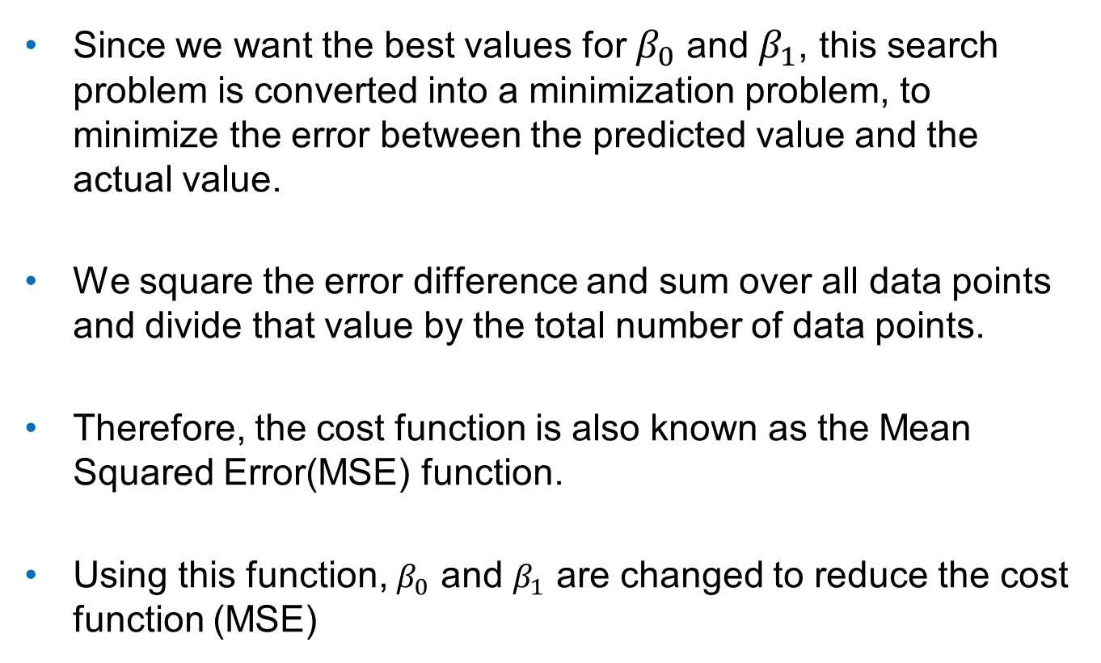
Cost Function
Since we want the best values for $β_{0}$ and $β_{1}$, this search problem is converted into a minimization problem, to minimize the error between the predicted value and the actual value.
We square the error difference and sum over all data points and divide that value by the total number of data points.
Therefore, the cost function is also known as the Mean Squared Error(MSE) function.
Using this function, $β_{0}$ and $β_{1}$ are changed to reduce the cost function (MSE)

Slide 9
Gradient Descent

Slide 10

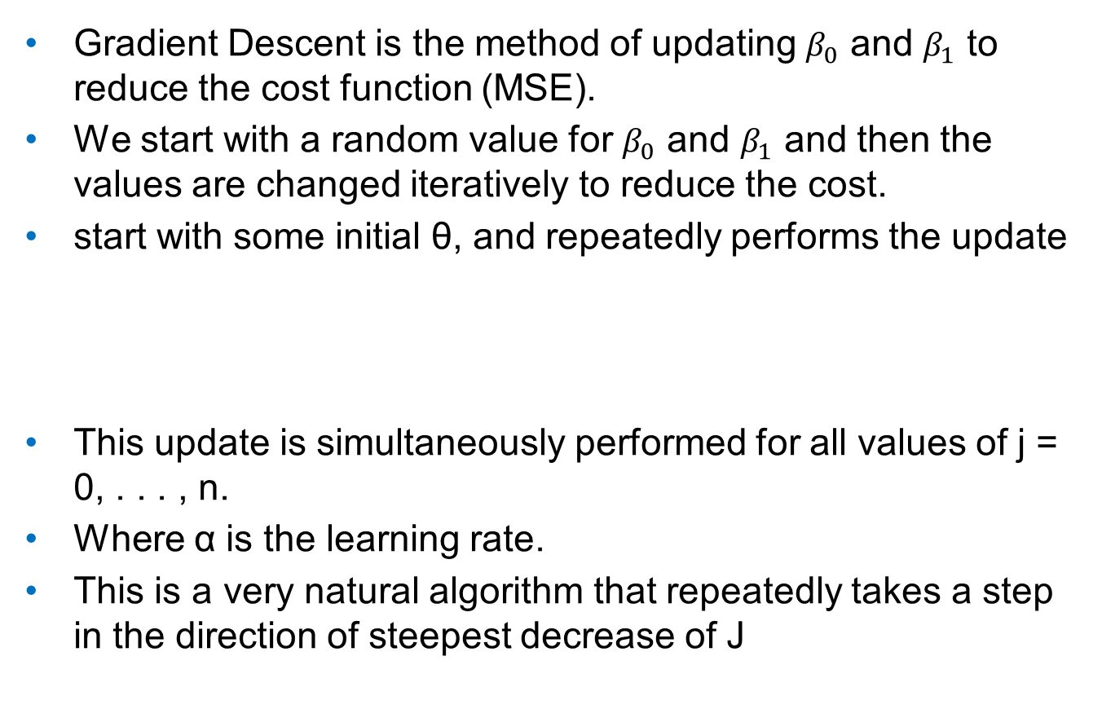
Gradient Descent
Gradient Descent is the method of updating $β_{0}$ and $β_{1}$ to reduce the cost function (MSE).
We start with a random value for $β_{0}$ and $β_{1}$ and then the values are changed iteratively to reduce the cost.
start with some initial θ, and repeatedly performs the update
This update is simultaneously performed for all values of j = 0, . . . , n.
Where α is the learning rate.
This is a very natural algorithm that repeatedly takes a step in the direction of steepest decrease of J

Slide 11
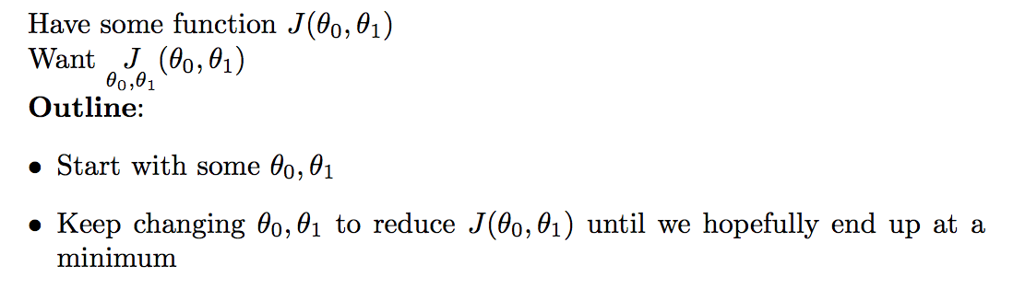
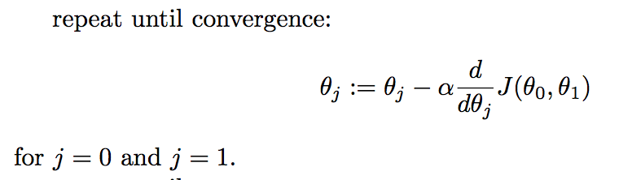
Gradient Descent

Slide 12
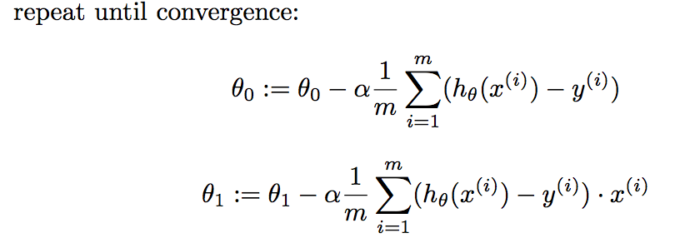
Gradient Descent

Slide 13
Regularization / Shrinkage methods

Slide 14
Regularization
Overfitting
Your model should ideally fit an infinite sample of the type of data you’re interested in.
In reality, you only have a finite set to train on. A good model for this subset is a good model for the infinite set, up to a point.
Beyond that point, the model quality (measured on new data) starts to decrease.
Beyond that point, the model is over-fitting the data.

Slide 15
Regularization
One way to deal with overfitting is regularization.
Overfitting is typically caused by inflation of the coefficients.
To avoid overfitting, the coefficients should be regulated by penalizing potential inflation of coefficients.
The coefficients are penalized by adding the coefficient terms to the cost function.
If the coefficients become large, the cost increases significantly.

Slide 16
Regularization
Approaches for adding a penalty to the cost function.
LASSO Regression
Ridge Regression
Elastic Net Regression

Slide 17
Ridge Regression

Slide 18
Ridge Regression
It is the summation of the squared value of coefficients.
Ridge helps to reduce or shrink the variance and making prediction less sensitive to the unwanted variable but not removes it
The shrinkage of the coefficients is achieved by penalizing the regression model with a penalty term called L2-norm, which is the sum of the squared coefficients.
The amount of the penalty can be fine-tuned using a constant called lambda (λ). Selecting a good value for λ is critical.
When λ=0, the penalty term has no effect, and ridge regression will produce the classical least square coefficients. However, as λ increases to infinite, the impact of the shrinkage penalty grows, and the ridge regression coefficients will get close zero.

Slide 19

Ridge Regression
L2 norm cost function to minimize is given below,
λ given here is actually denoted by alpha parameter in the ridge function. So by changing the value of alpha we are controlling the penalty term

Slide 20
Ridge Regression
It shrinks the parameters, therefore it is mostly used to prevent multicollinearity.
One important advantage of the ridge regression,
It still performs well, compared to the ordinary least square method in a situation where you have a large multivariate data with the number of predictors (p) larger than the number of observations (n).
One disadvantage of the ridge regression,
It will include all the predictors in the final model, unlike the stepwise regression methods which will generally select models that involve a reduced set of variables.
Ridge regression shrinks the coefficients towards zero, but it will not set any of them exactly to zero. The lasso regression is an alternative that overcomes this drawback.

Slide 21
LASSO Regression

Slide 22
LASSO Regression
It is “Least Absolute Shrinkage and Selection Operator”
It is the summation of the absolute value of the coefficients.
It shrinks the regression coefficients toward zero by penalizing the regression model with a penalty term called L1-norm, which is the sum of the absolute coefficients.
LASSO is used when you have more variables and when you want to remove unwanted variables to the model, as it can bring the value to 0
Lasso can be also seen as an alternative to the subset selection methods for performing variable selection in order to reduce the complexity of the model.

Slide 23

LASSO Regression
L1 norm cost function to minimize is given below,
λ is the hypermeter, whose value is equal to the alpha in the Lasso function

Slide 24
LASSO Regression
LASSO is generally used when we have more number of features, because it automatically does feature selection.
One obvious advantage of lasso regression over ridge regression,
It produces simpler and more interpretable models that incorporate only a reduced set of the predictors.
However, neither ridge regression nor the lasso will universally dominate the other.

Slide 25
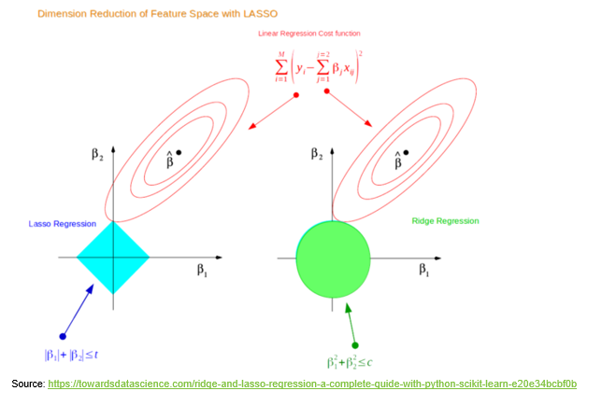
Dimension reduction of feature space - LASSO and Ridge
lasso and ridge regression coefficient estimates are given by the first point at which an ellipse contacts the constraint region.

Slide 26
LASSO and Ridge
The lasso has a major advantage over ridge regression, in that it produces simpler and more interpretable models that involved only a subset of predictors.
The lasso leads to qualitatively similar behavior to ridge regression, in that as λ increases, the variance decreases and the bias increases.
The lasso can generate more accurate predictions compared to ridge regression.
Cross-validation can be used in order to determine which approach is better on a particular data set.

Slide 27
Selecting the Tuning Parameter λ
As for subset selection, for ridge regression and lasso we require a method to determine which of the models under consideration in best; thus, we required a method selecting a value for the tuning parameter λ or equivalently, the value of the constraint s.
Select a grid of potential values; use cross-validation to estimate the error rate on test data (for each value of λ) and select the value that gives the smallest error rate.
Finally, the model is re-fit using all of the variable observations and the selected value of the tuning parameter λ.

Slide 28
Elastic Net Regression
Elastic Net produces a regression model that is penalized with both the L1-norm and L2-norm.
It is a combination of both L1 and L2 regularization.
The consequence of this is to effectively shrink coefficients (like in ridge regression) and to set some coefficients to zero (as in LASSO).

Slide 29

Elastic Net Regression
It uses both L1 and L2 penalty term
Cost function to minimize is,

Slide 30
Elastic Net Regression
Advantages:
Removes the limitation on the number of selected variables
Encourages grouping effect
Stabilizes the l1 regularization path.

Slide 31
Conclusion
Understand best subset selection and stepwise selection methods for reducing the number of predictor variables in regression.
Indirectly estimate test error by adjusting training error to account for bias due to overfitting
Adjusted R²
AIC (Akaike information criterion)
BIC (Bayesian information criterion)
Mallow’s C_{p} (equivalent to AIC for linear regression)
Directly estimate test error using validation set approach and cross-validation approach.
Understand and know how to perform ridge regression and the lasso as shrinkage (regularization) methods.

Slide 32
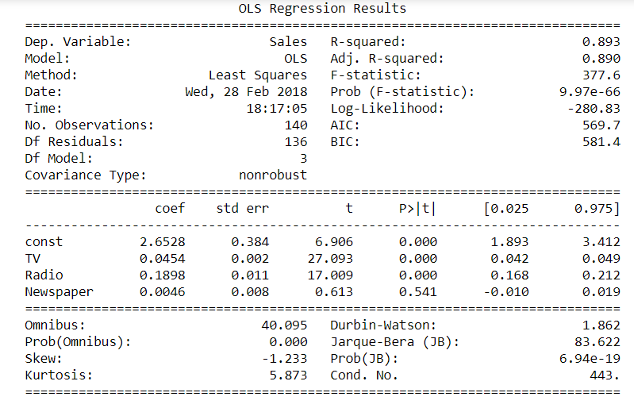
Understanding the Regression output

Slide 33
Gradient Descent

Slide 34
Model Validation
It is desired that the R-squared between the predicted value and the actual value in the test set should be high.
In general, it is desired that the R-squared on the test data be high, and as similar to the R-squared on the training set as possible.
We should note that R-squared is only one of the metric among many other metrics to assess accuracy in a linear regression model.

Slide 35
Generalization vs. Memorization
Generalization: The ability to predict or assign a label to a “new” observation based on the “model” built from past experience

Slide 36
Model SIGNAL not NOISE
Model is too simple → UNDER LEARN
Model is too complex → MEMORIZE
Model is just right → GENERALIZE

Slide 37
Generalize, don’t Memorize!
Training Set Accuracy
Right Level of Model Complexity
Model Accuracy
Validation Set Accuracy
Model Complexity

Slide 38
Questions?

